Slide 1
Worksheets for students
5. Area of shapes lesson #1

Slide 2
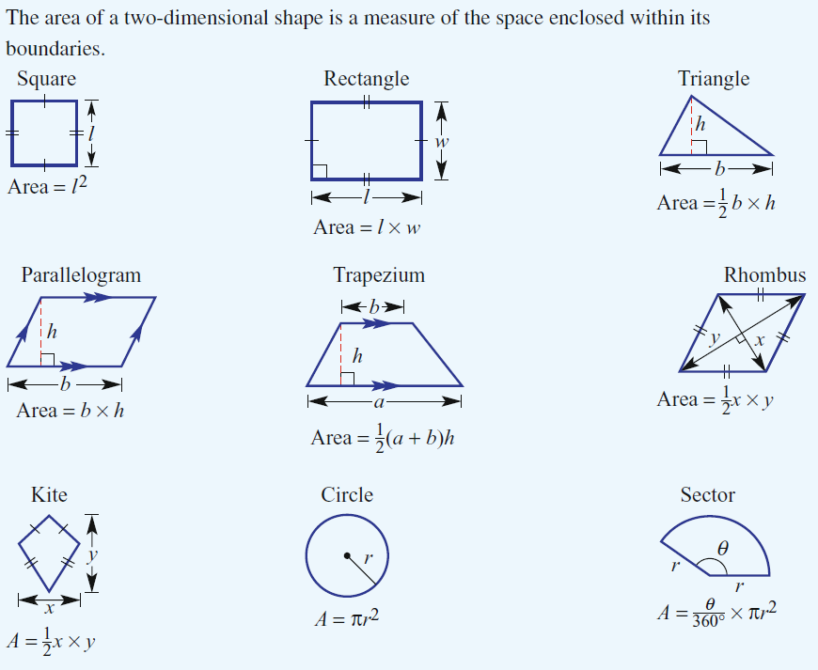
Basic Shape Formulas

Slide 3
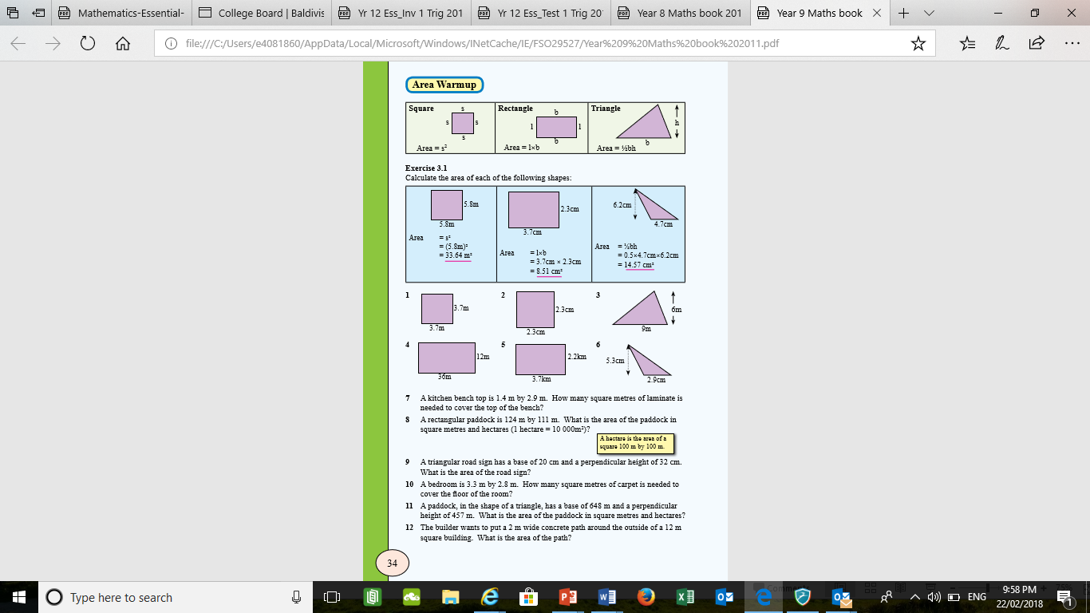
More Practice finding the area

